Slide 1



Utiva CredPal Hackathon
View in Power BI
Last data refresh:
12/11/2021 11:48:19 AM UTC
Downloaded at:
12/11/2021 11:58:58 AM UTC

Slide 2
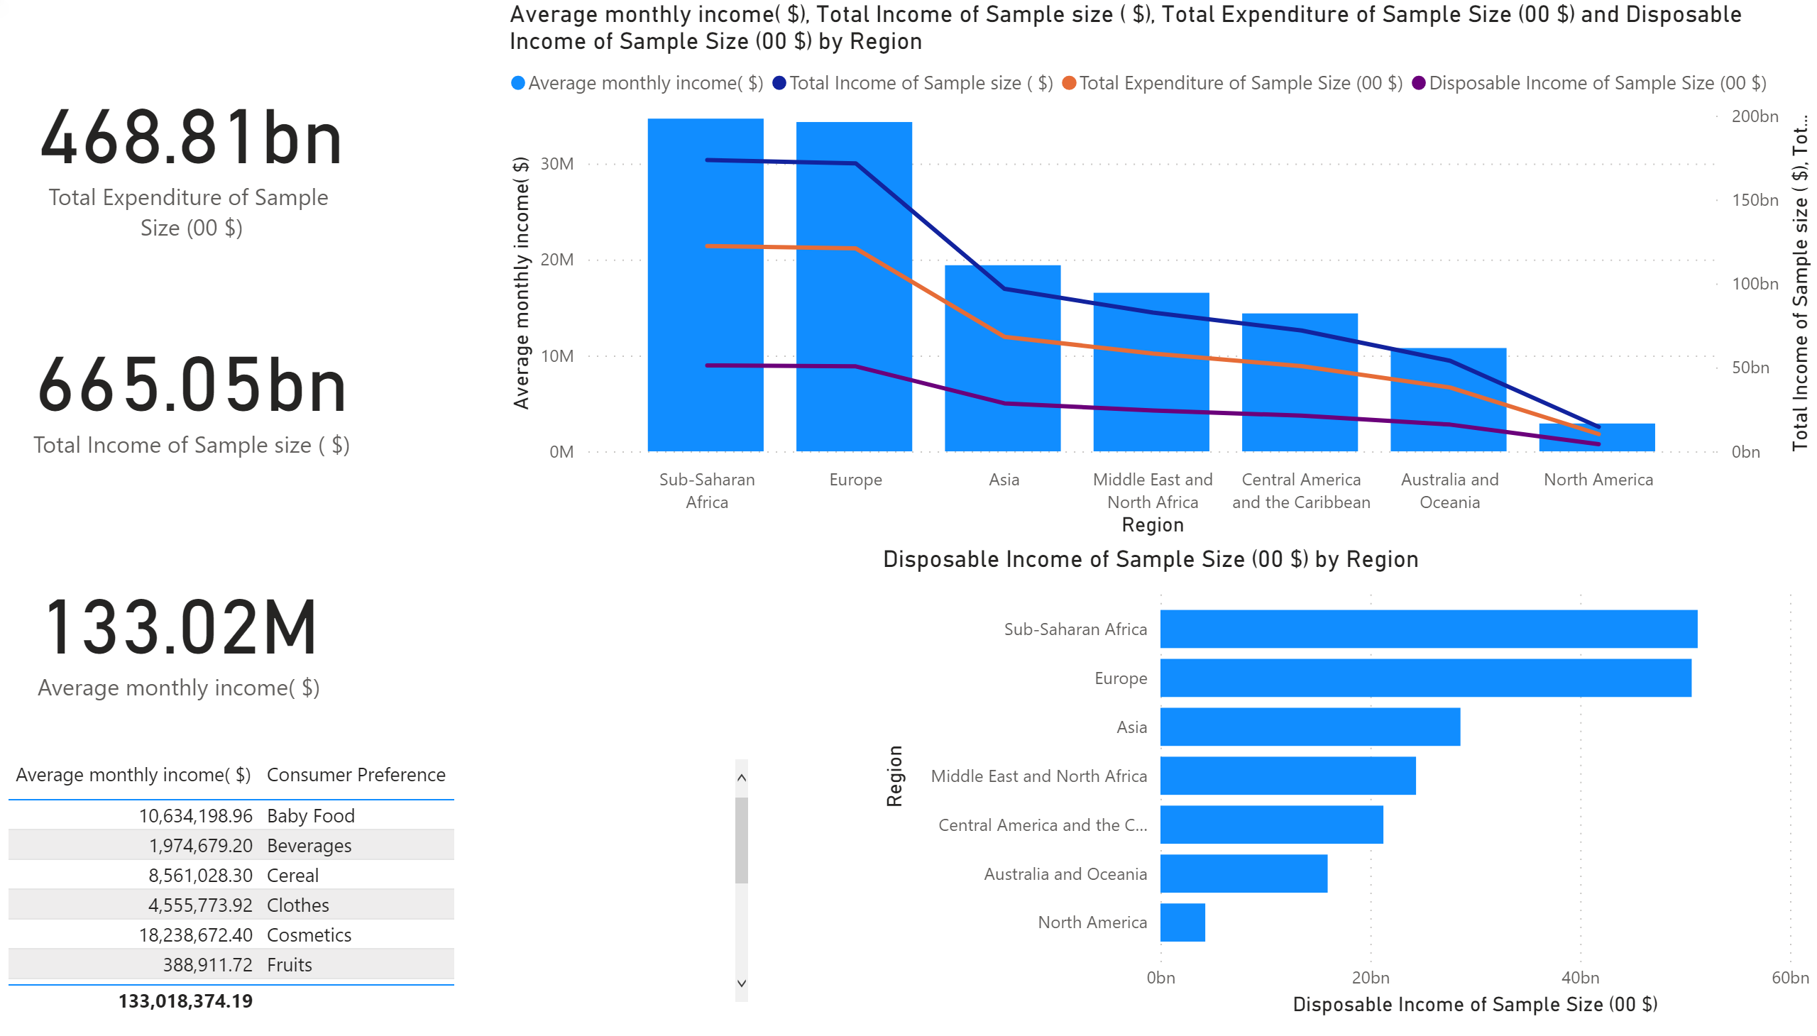
Page 1
Notes:
card
No alt text provided.
card
No alt text provided.
lineClusteredColumnComboChart
No alt text provided.
card
No alt text provided.
barChart
No alt text provided.
tableEx
No alt text provided.

Slide 3
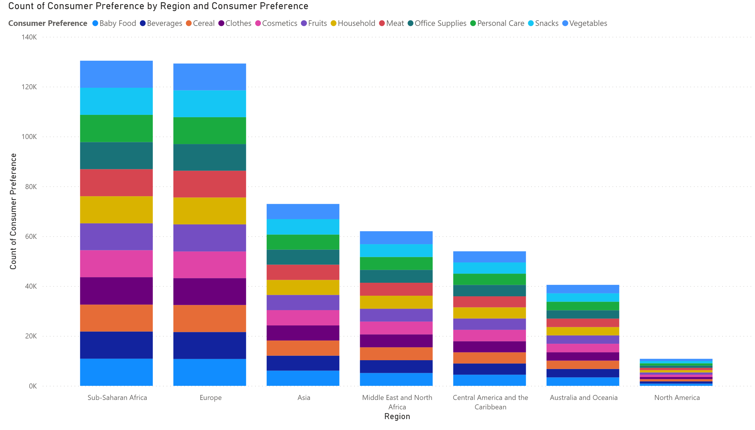
Page 2
Notes:
columnChart
No alt text provided.

Slide 4
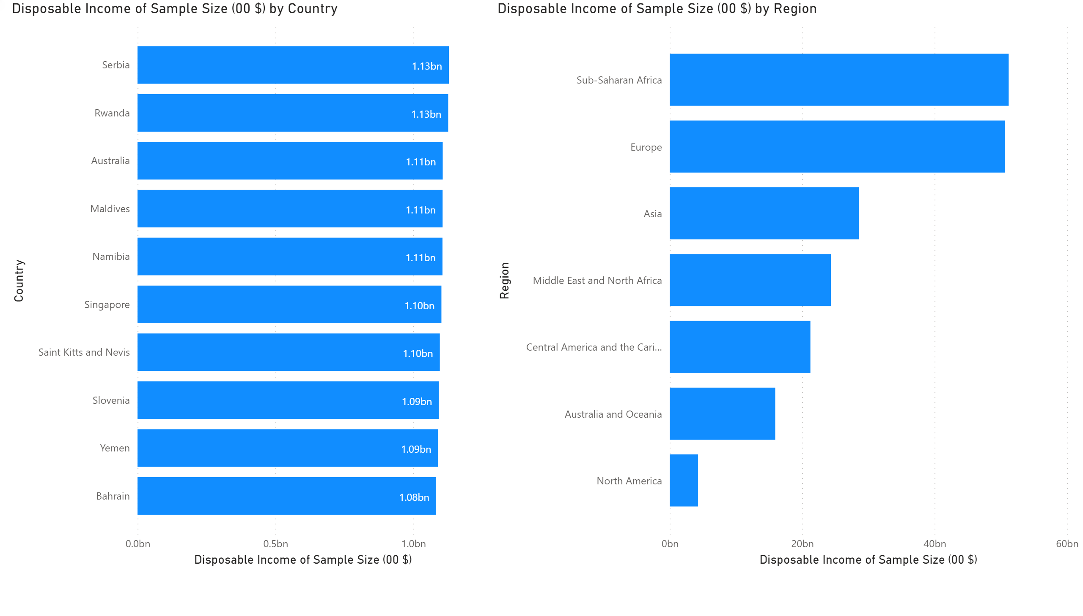
Page 3
Notes:
barChart
No alt text provided.
barChart
No alt text provided.

Slide 5
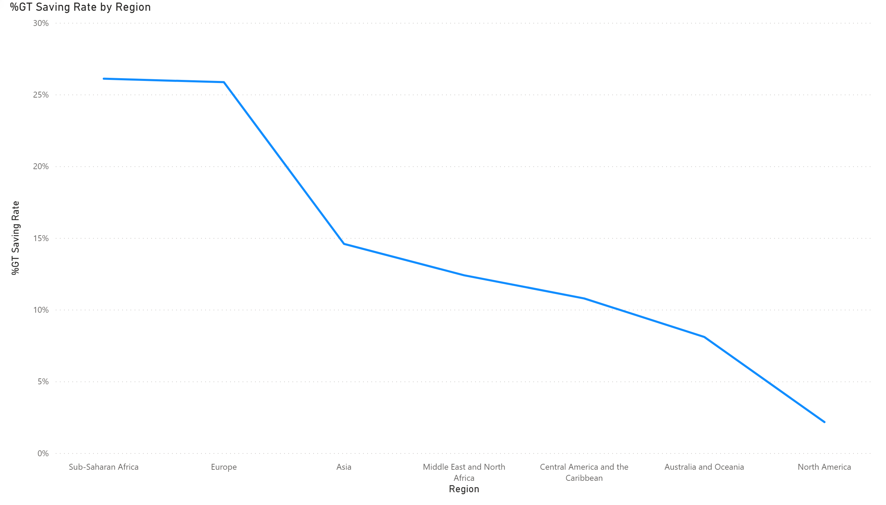
Page 4
Notes:
lineChart
No alt text provided.

Slide 6
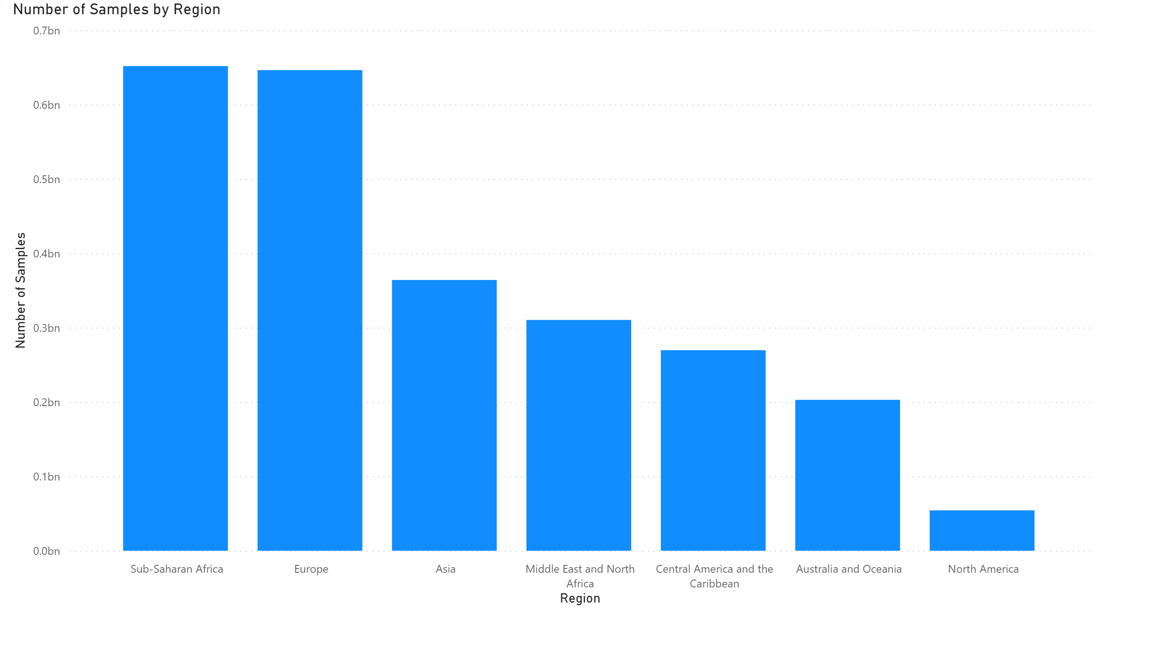
Page 5
Notes:
columnChart
No alt text provided.

Slide 7
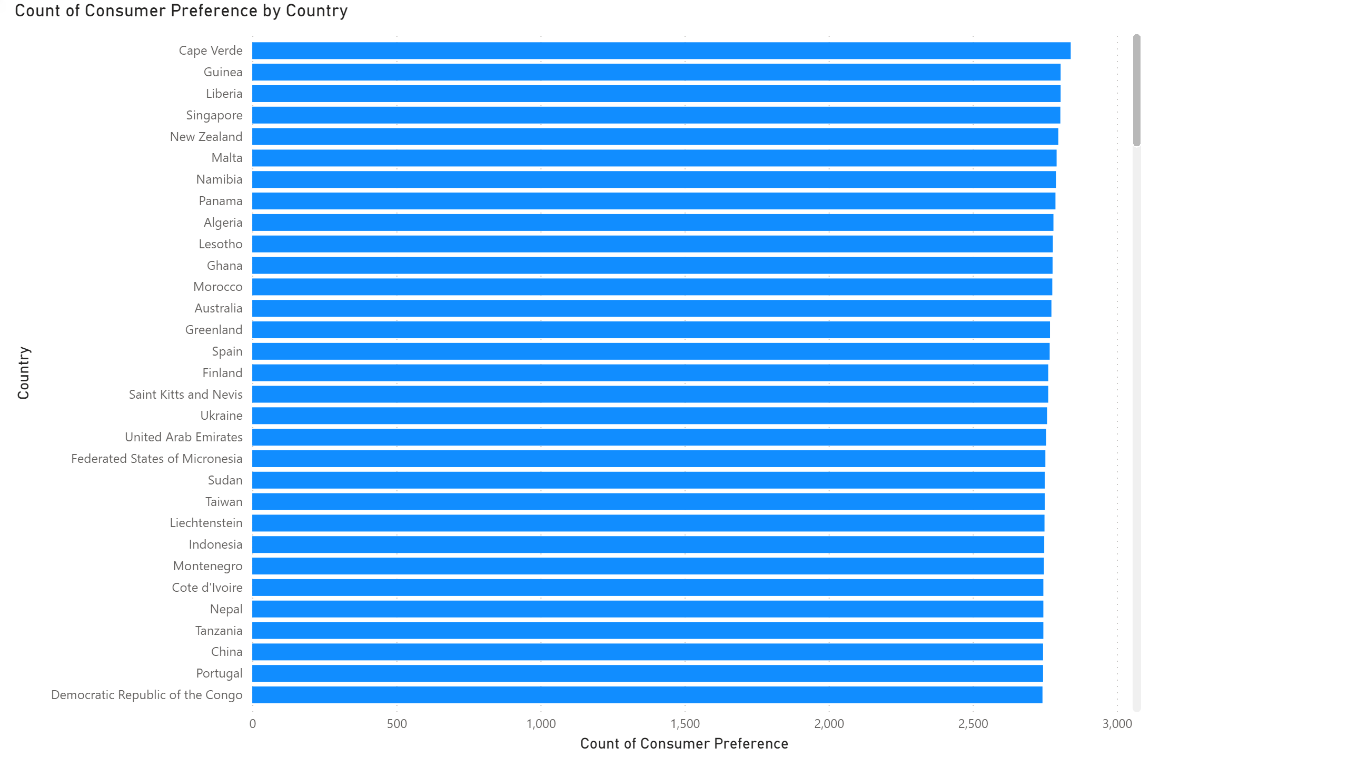
Page 6
Notes:
barChart
No alt text provided.

Slide 8
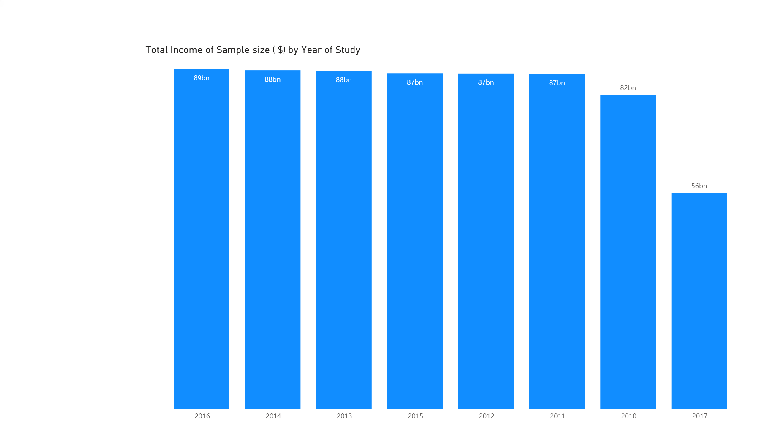
Page 7
Notes:
columnChart
No alt text provided.

